Slide 1

How do Organisms
Reproduce?
Introduction

Slide 2

Before we discuss the mechanisms by which organisms reproduce,
let us understand why do organisms reproduce???

Slide 3


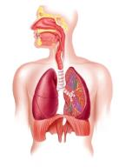
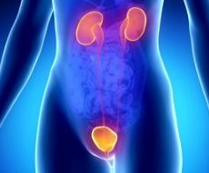
After all, reproduction is not necessary to maintain the life of an individual organism, unlike the essential life processes such as nutrition, respiration, or excretion.

Slide 4
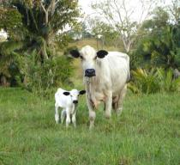
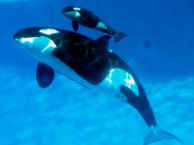
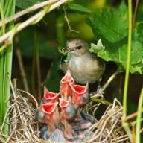


Also, if an individual organism is going to create more individuals, a lot of its energy will be spent in the process.
So why should an individual organism waste energy on a process it does not need to stay alive?

Slide 5
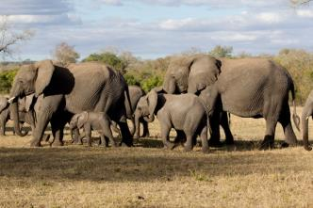
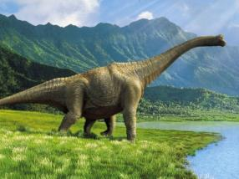

It is obvious that we notice organisms because they reproduce.
If there were to be only one, non-reproducing member of a particular kind, it is doubtful that we would have noticed its existence.

Slide 6
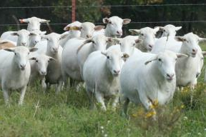
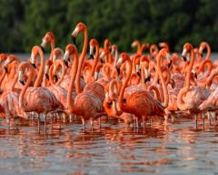
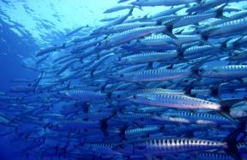
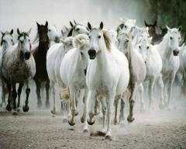
It is the large numbers of organisms belonging to a single species that bring them to our notice.

Slide 7
How do we know that
two different individual organisms belong to the same species?

Slide 8
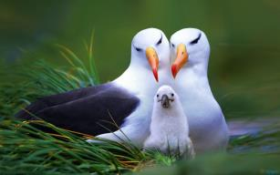

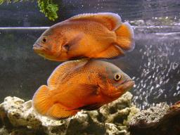
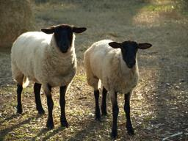
Usually, we say this because they look similar to each other.

Slide 9
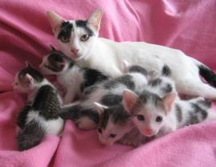

Thus, reproducing organisms create new individuals that look very much like themselves.

Slide 10

Do organisms create exact copies of themselves???

Slide 11
Thank You

